Slide 1


React
Creating Single page web applications with React
Արձագանք
Մեկ էջով ցանցային ծրագրի ստեղծումը Արձագանքով
JULY 15, 2016

Slide 2
Creating Single page web applications with React
Why React?
Virtual DOM, Reconciliation, Server-side rendering
React and JSX syntax
State and props
Component Lifecycle
Modules, ES6, Babel, Webpack
CSS and Inline Styles

Slide 3
1. Why React?
React is a JavaScript library for creating user interfaces.
React makes it painless to create interactive UIs. Design simple views for each state in your application, and React will efficiently update and render just the right components when your data changes.
Build encapsulated components that manage their own state, then compose them to make complex UIs.
Since component logic is written in JavaScript instead of templates, you can easily pass rich data through your app and keep state out of the DOM.
What is React?
Declarative
Composable Components

Slide 4
2. Virtual DOM, Reconciliation, Server-side rendering
Virtual DOM is a light weight copy of our DOM. Rather than touching the DOM directly, we build an abstract version of it. We can change it as we want and then save to our real DOM tree. While saving we should compare, find difference and change (re-render) what should be changed.
It is much faster than working directly with DOM, because of:
Efficient diff algorithms.
Batching DOM read/write operations.
Efficient update of sub-tree only.
Virtual DOM

Slide 5
Virtual DOM, Reconciliation, Server-side rendering
With powerful heuristics we managed to turn a O(n³) problem into a O(n) one.
The implemented O(n) algorithm is using heuristics based on two assumptions:
Two components of the same class will generate similar trees and two components of different classes will generate different trees.
It is possible to provide a unique key for elements that is stable across different renders.
Reconciliation

Slide 6
Virtual DOM, Reconciliation, Server-side rendering
One of the great things about React is that it doesn't require the DOM as a dependency, which means it is possible to render a React application on the server and send the HTML markup down to the client. This is important feature for first page preloading and SEO support.
Node.js
ASP.NET with ReactJS.NET, ASP.NET Core with JavaScriptServices
Nashorn JavaScript engine in Java 8
Server-side rendering

Slide 7
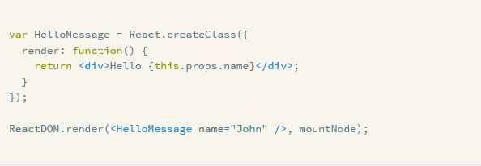
3. React and JSX syntax
JSX is a JavaScript syntax extension that looks similar to XML. You can use a simple JSX syntactic transform with React.
Create React component

Slide 8
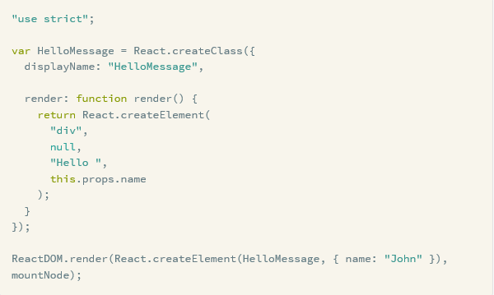
React and JSX syntax
with React.
JSX compiled to JavaScript

Slide 9
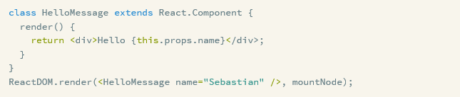

React and JSX syntax
ES6 classes and Stateless Functions

Slide 10
4. State and props
State is best described as how a component’s data looks at a given point in time
React thinks of UIs as simple state machines. UI is in various states and renders those states. Simply update a component's state, and then React will render a new UI based on this new state. React takes care of updating the DOM for you in the most efficient way.
A common way to inform React of a data change is by calling setState(data, callback). This method merges data into this.state and re-renders the component.
Props are like parameters to components and used as a way of passing data from parent to child. Props are immutable and used just as communication channel between components, always moving from parent to child.
React state
React props

Slide 11
5. Component Lifecycle
void componentWillMount() - Invoked once, both on the client and server, immediately before the initial rendering occurs.
void componentDidMount() - Invoked once, only on the client (not on the server), immediately after the initial rendering occurs.
(These methods are not called for the initial render)
void componentWillReceiveProps( object nextProps ) - Invoked when a component is receiving new props.
boolean shouldComponentUpdate( object nextProps, object nextState ) - Invoked before rendering when new props or state are being received.
void componentWillUpdate( object nextProps, object nextState ) - Invoked immediately before rendering when new props or state are being received.
void componentDidUpdate( object prevProps, object prevState ) - Invoked immediately after the component's updates are flushed to the DOM.
void componentWillUnmount() - Invoked immediately before a component is unmounted from the DOM.
Mounting
Updating
Unmounting

Slide 12


6. Modules, ES6, Babel, Webpack
CommonJS modules
ES6 modules
CDN or server hosted React
Using React with modules

Slide 13
Modules, ES6, Babel, Webpack
Babel is a JavaScript compiler for using next generation JavaScript, today. It takes ES6, JSX files and transpiles them into ES5 JavaScript code.
Webpack is a module bundler. Webpack takes modules with dependencies and generates static assets representing those modules. Webpack can only process JavaScript natively, but loaders are used (for example Babel) to transform other resources into JavaScript. Webpack also features a rich plugin system.
Webpack has Hot Module Replacement (HMR), which exchanges, adds, or removes modules while an application is running without a page reload.
Babel
Webpack

Slide 14
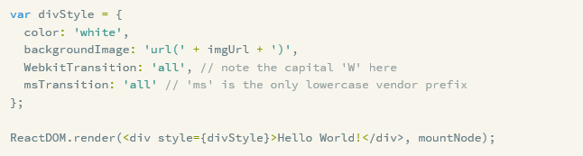
7. CSS and Inline Styles
React components have className property (as class is reserved word in JavaScript), which you can set to any class defined in CSS files or style tags.
Inline styles are isolated at component level and make it possible to write self-contained reusable components.
CSS
Inline Styles

